Slide 1
STOCK MARKET ANALYSIS DASHBOARD
Domain: Business Analyst
Tool Used: Power BI
Dataset: Historical Stock Price Data
Project Level: Intermediate
Description:
This project analyzes historical stock market data of major companies including Apple Inc, Microsoft Corp, Google Inc, and Netflix Inc. The dashboard provides insights into price trends, trading volume, volatility, and comparative stock performance to support data-driven investment analysis.

Slide 2
PROBLEM STATEMENT
Stock market data is highly dynamic and complex, making it difficult for investors and analysts to identify trends, price movements, and risk levels without proper analytical tools.
Challenges Addressed:
Understanding stock price trends over time
Comparing performance across multiple companies
Identifying high and lowprice ranges
Measuring volatility and daily returns
Analyzing trading volume patterns

Slide 3
PROJECT OBJECTIVES
Objectives
Analyze stock closing price trends
Calculate moving averages for trend smoothing
Measure stock volatility and daily returns
Compare stock performance across companies
Provide interactive insights using Power BI dashboards

Slide 4
DATA PREPARATION (TECHNIQUES)
Steps Performed:
Imported historical stock price dataset into Power BI
Cleaned and validated price and volume data
Created date hierarchy (Date, Month, Year)
Verified numeric fields such as Open, High, Low, Close, and Volume
Key Fields Used:
Date
Company Name
Open, High, Low, Close Prices
Volume
Purpose:
To ensure accurate, consistent, and reliable stock market analysis.

Slide 5
CALCULATIONS & KPIs
Measures Created:
Highest Closing Price=MAX(FactStockPrice[Close])
Lowest Closing Price=MIN(FactStockPrice[Close])
Total Trading Volume=MAX(FactStockPrice[Volume])
Daily Returns=DIVIDE(MAX(FactStockPrice[Close])MAX(FactStockPrice[Open]),MAX(FactStockPrice[Open]))
Volatility (Standard Deviation)=CALCULATE( STDEVX.P(FactStockPrice, FactStockPrice[Daily Return]))
Example Calculation:
Purpose:
To quantify stock performance, risk, and price movement behavior.
Daily Return = (Close − Previous Close) / Previous Close

Slide 6
VISUALIZATION TECHNIQUES
Visualization Techniques Used
KPI Cards for key stock metrics
Line Charts for price and trend analysis
Bar Charts for volume and comparison
Clustered Charts for high vs low price comparison
Table visual for detailed stock records
Interactivity:
Slicers (Company Name, Date, Month-Year)
Cross-filtering and drill-down
Clear slicer button

Slide 7
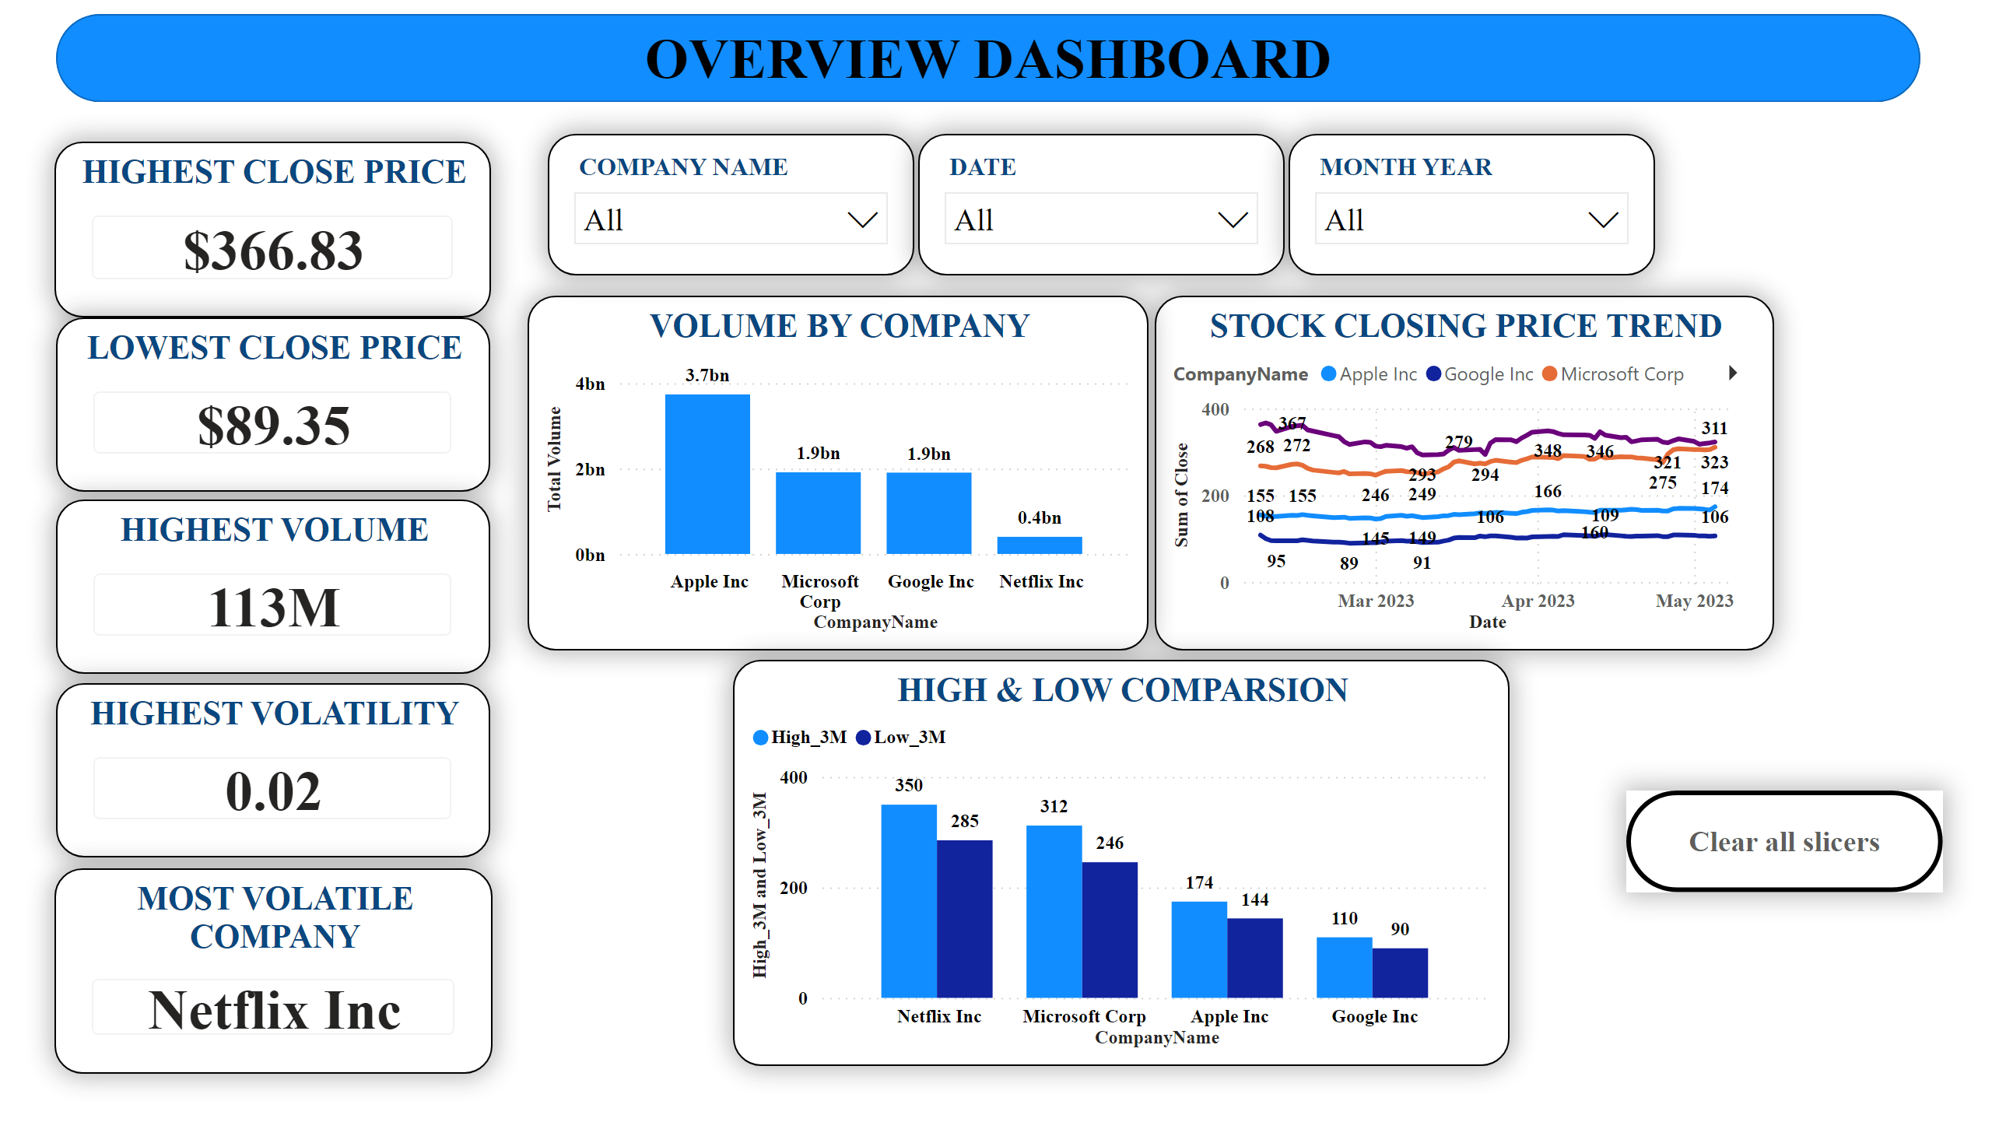
Dashboard Highlights:
Highest and lowest closing prices
Highest trading volume
Most volatile company identification
Stock closing price trends
High and lowprice comparison across companies
Purpose:
Provide a high-level summary of overall stock market performance

Slide 8
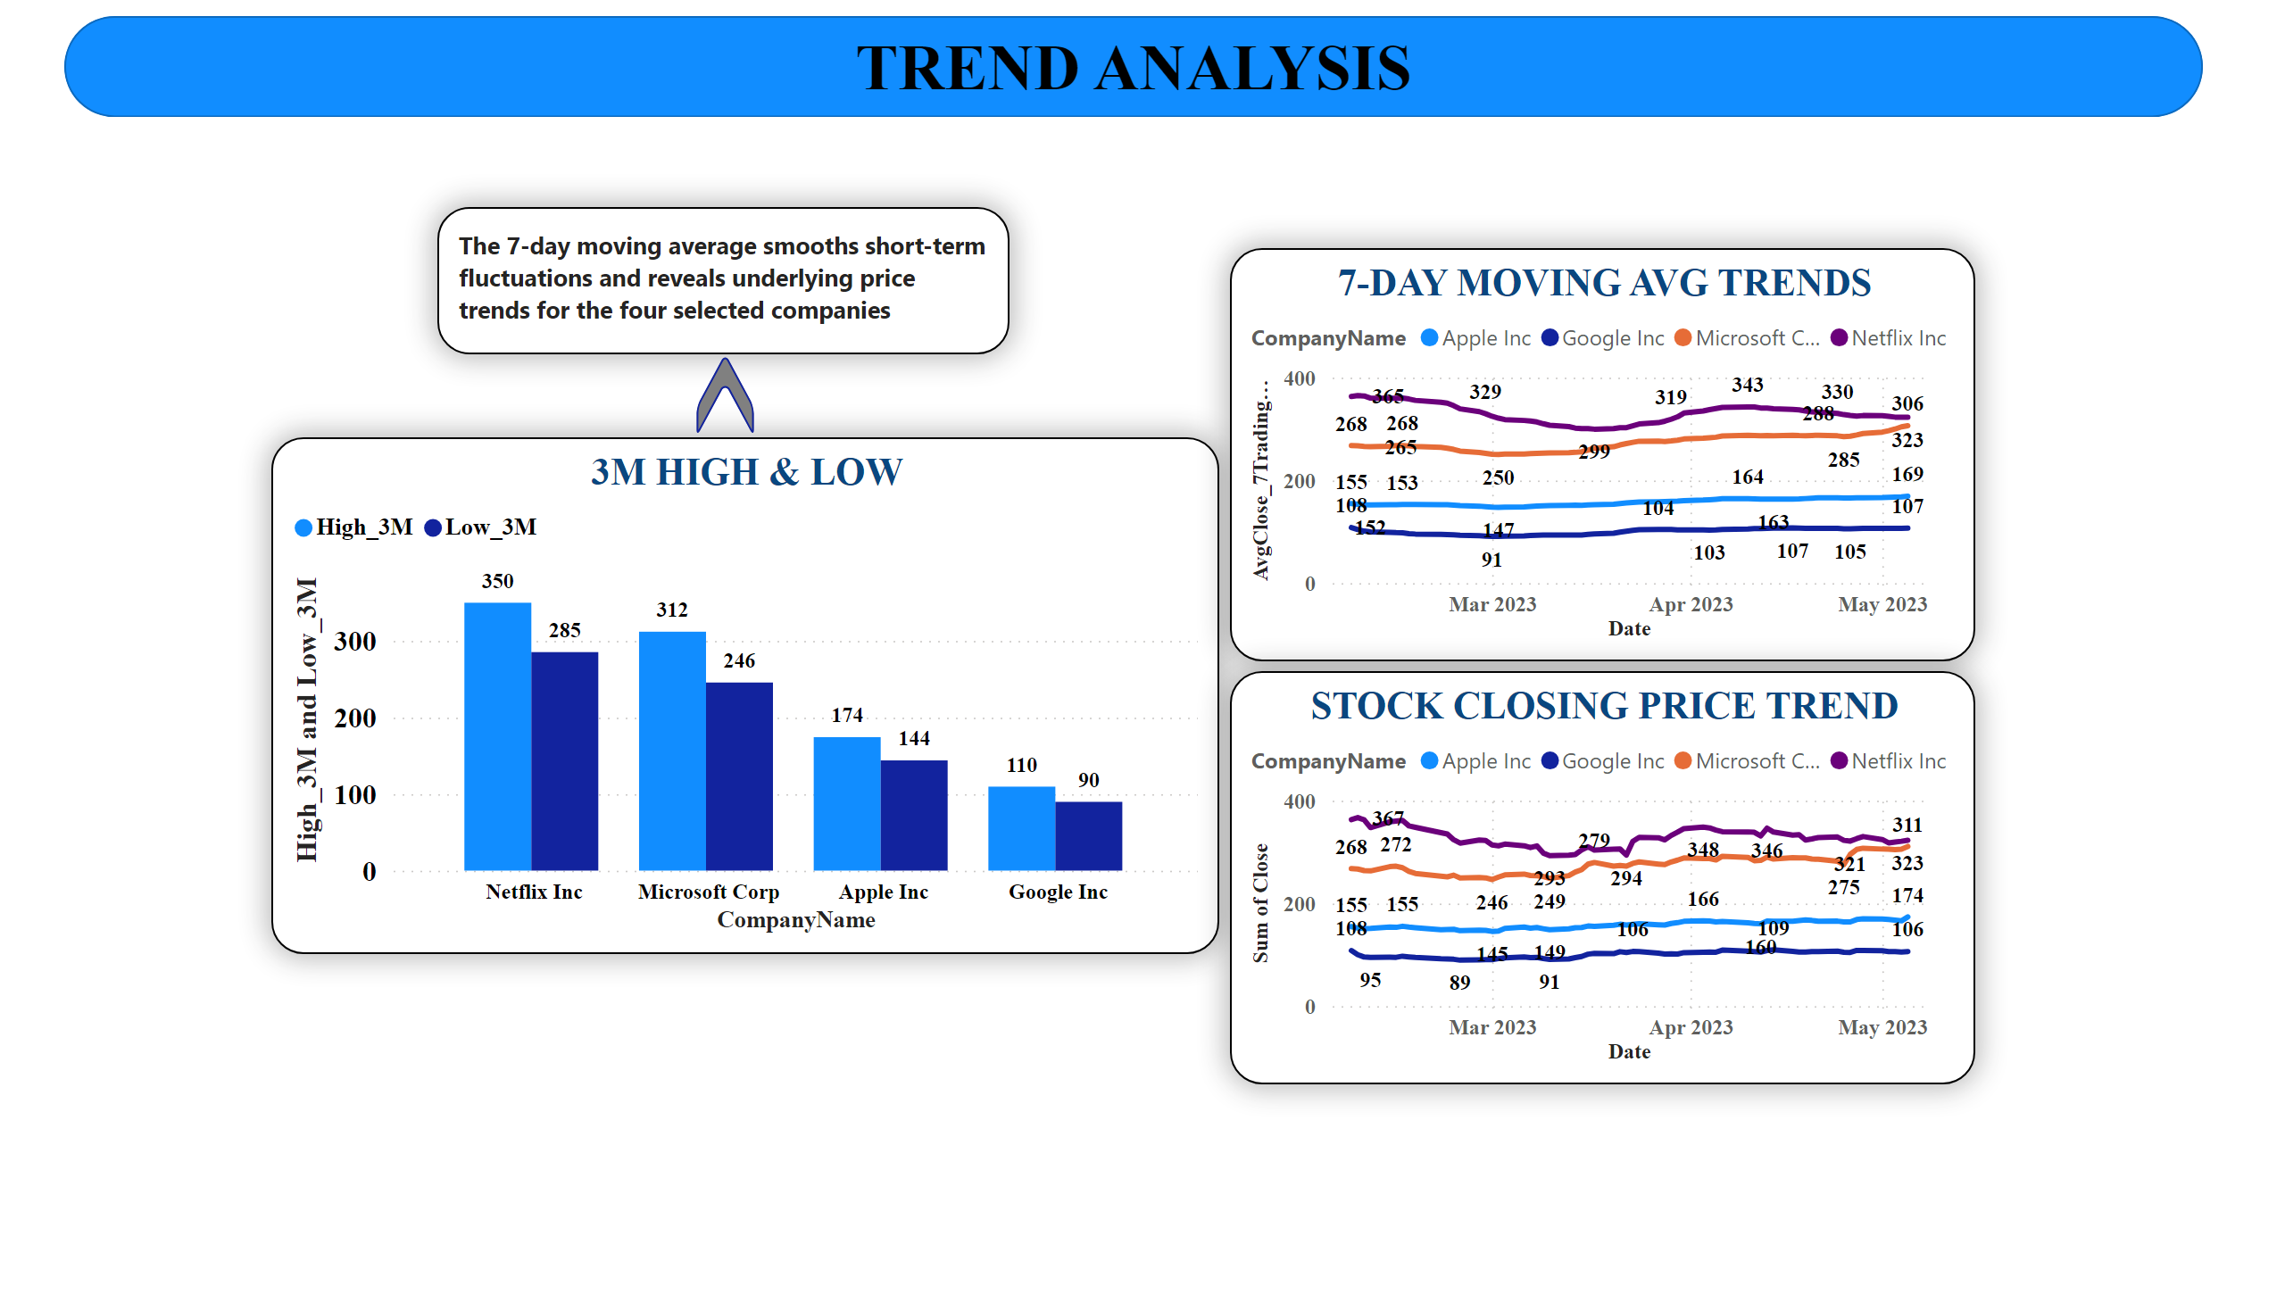
Insights:
7-day moving average smooths short-term fluctuations
Netflix Inc shows higher price range compared to others
Apple and Microsoft exhibit relatively stable upward trends
Trend analysis helps identify long-term price direction

Slide 9
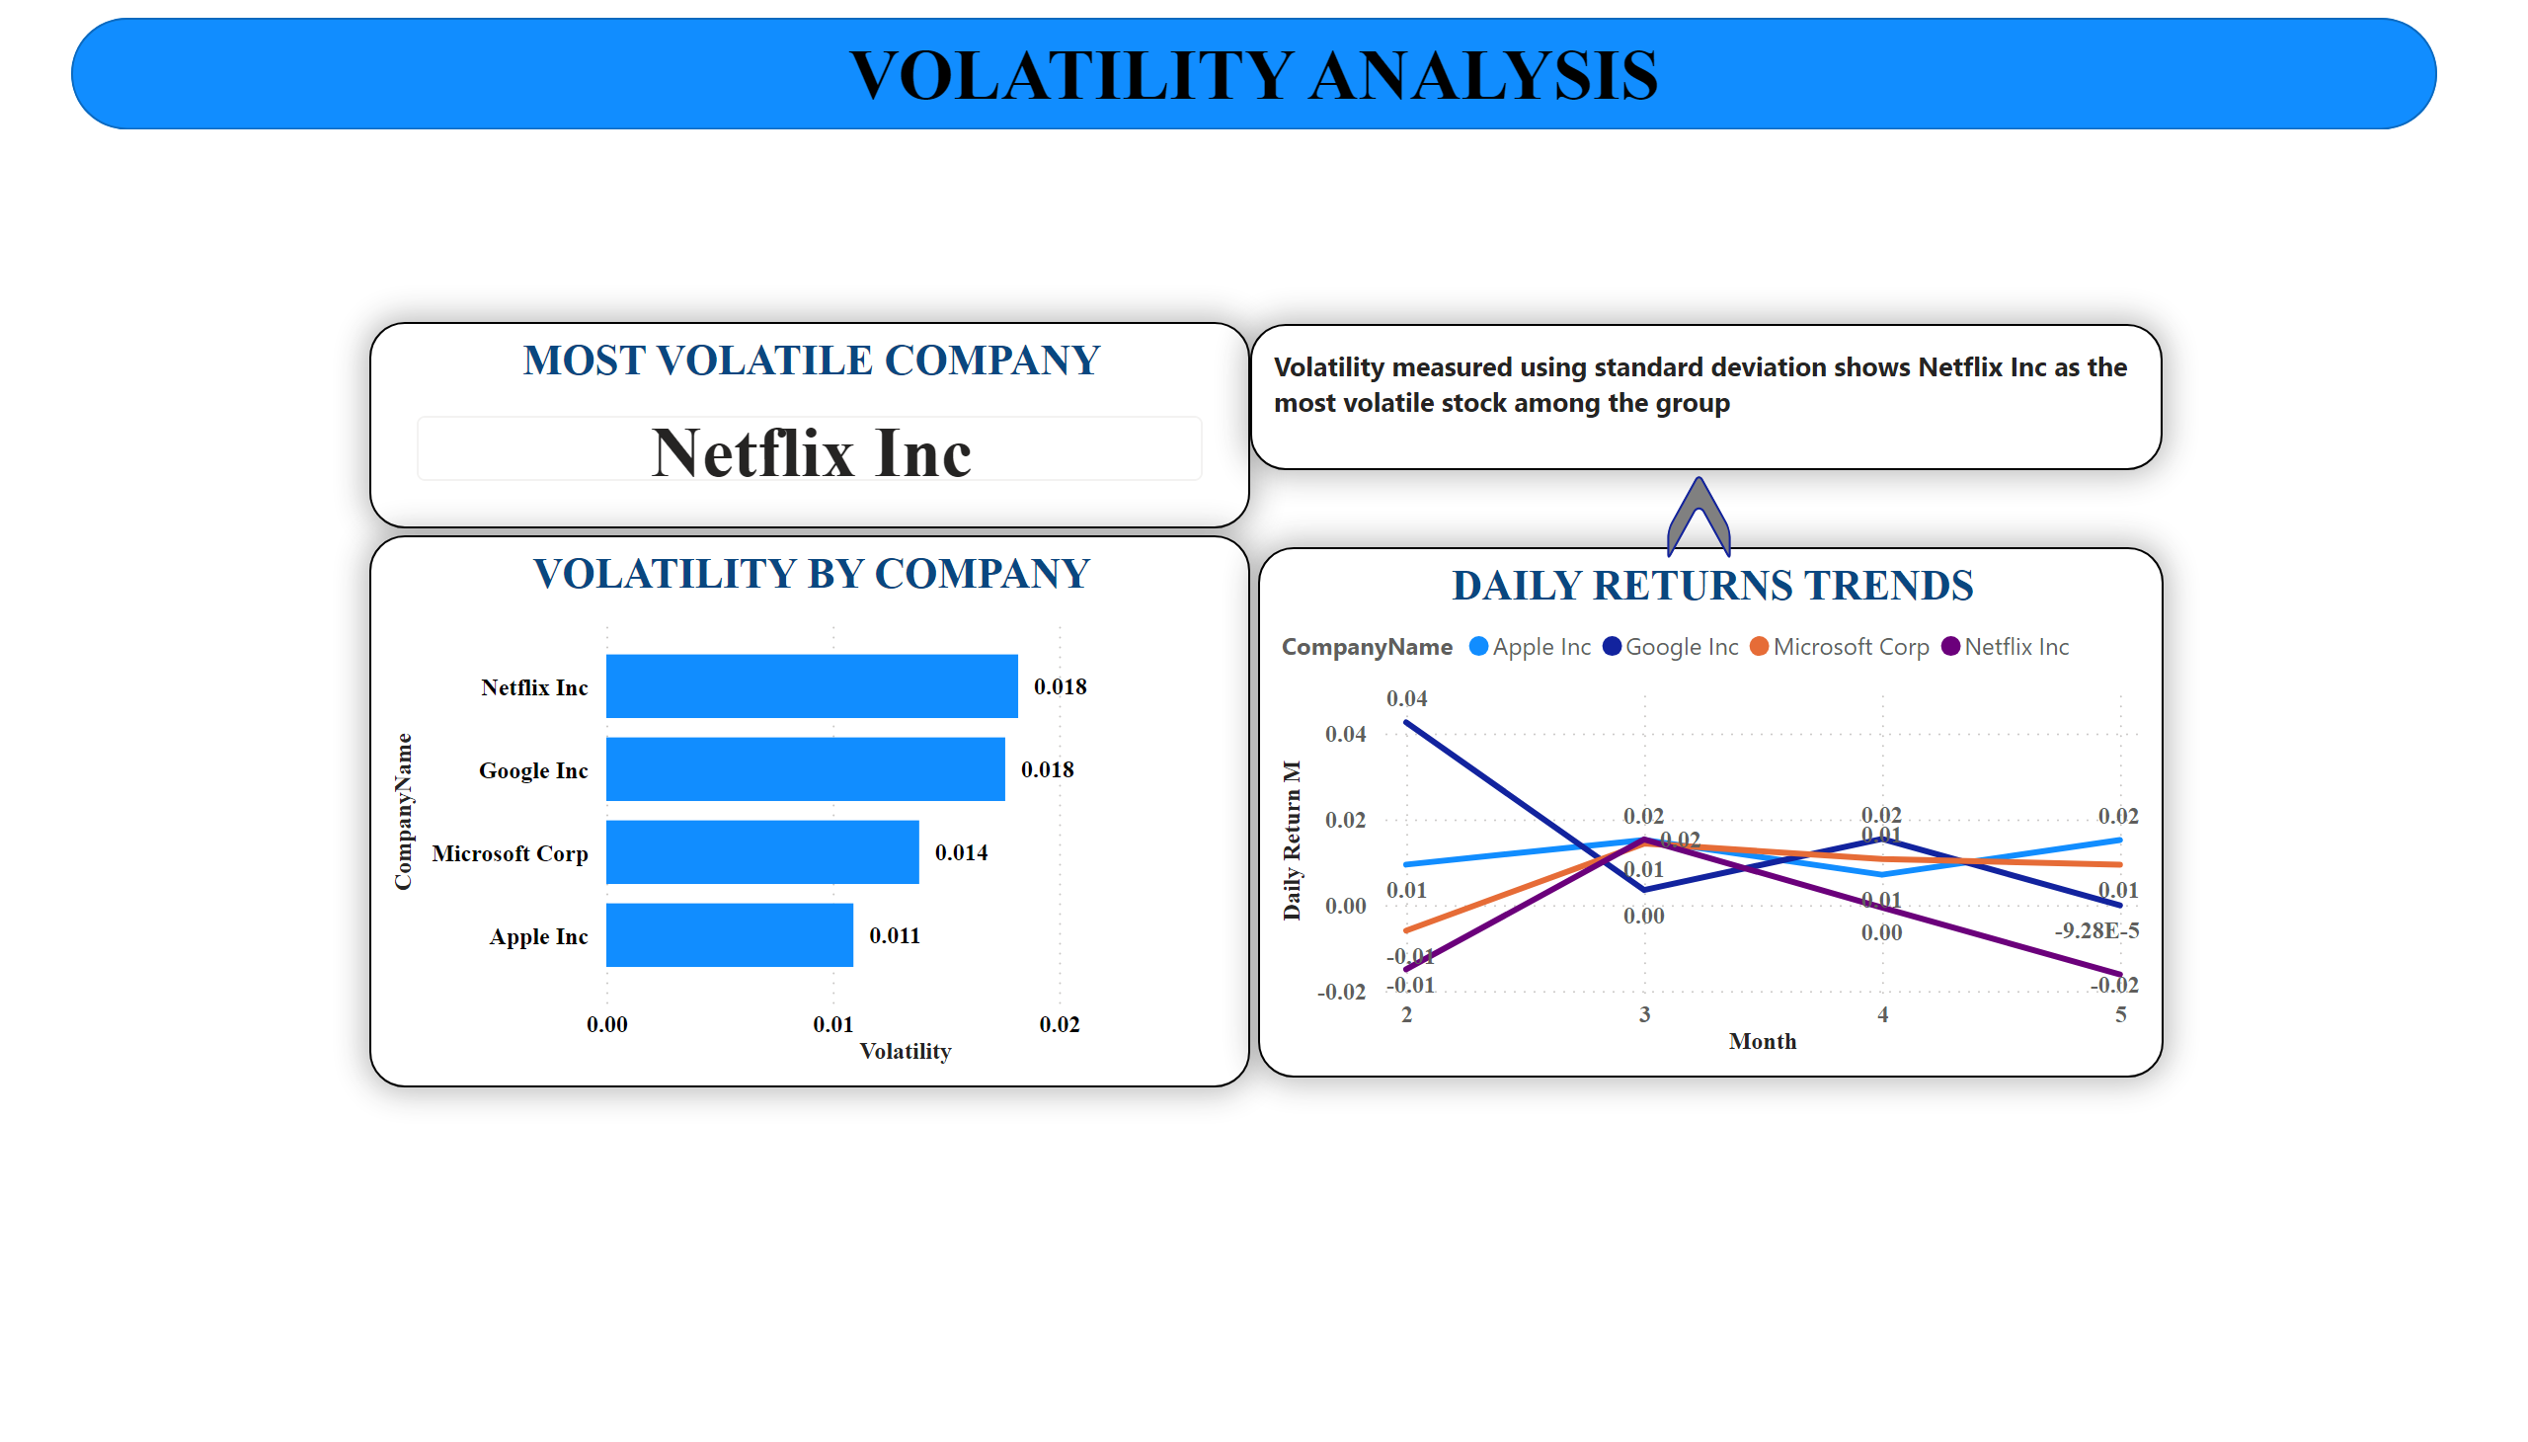
Insights:
Volatility measured using standard deviation
Netflix Inc is identified as the most volatile stock
Apple Inc shows comparatively lower volatility
Daily return trends highlight risk and price fluctuations

Slide 10
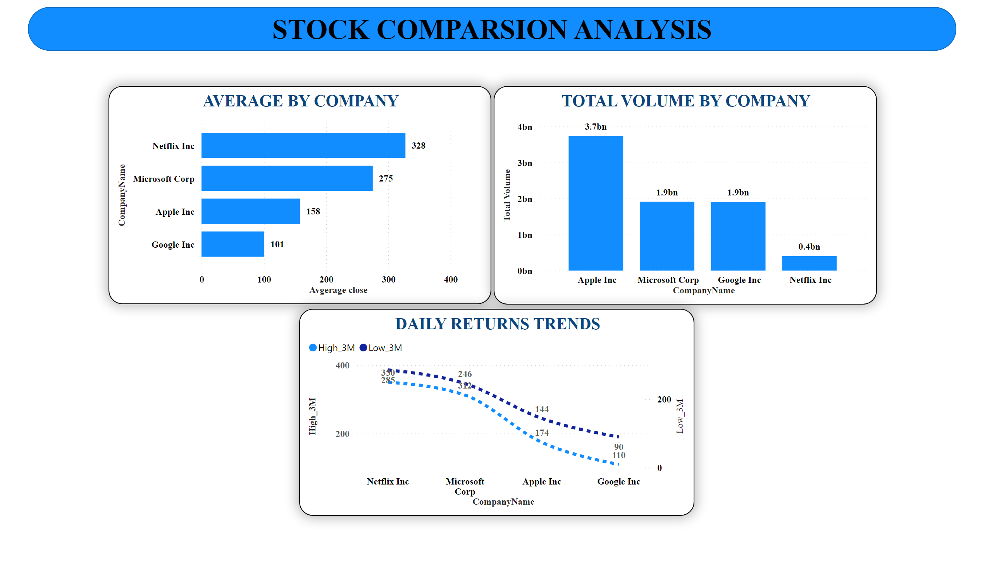
Insights:
Netflix Inc has the highest average closing price
Apple Inc records the highest trading volume
Google Inc shows lower price and volume levels
High vs Low price comparison reveals price spread differences

Slide 11
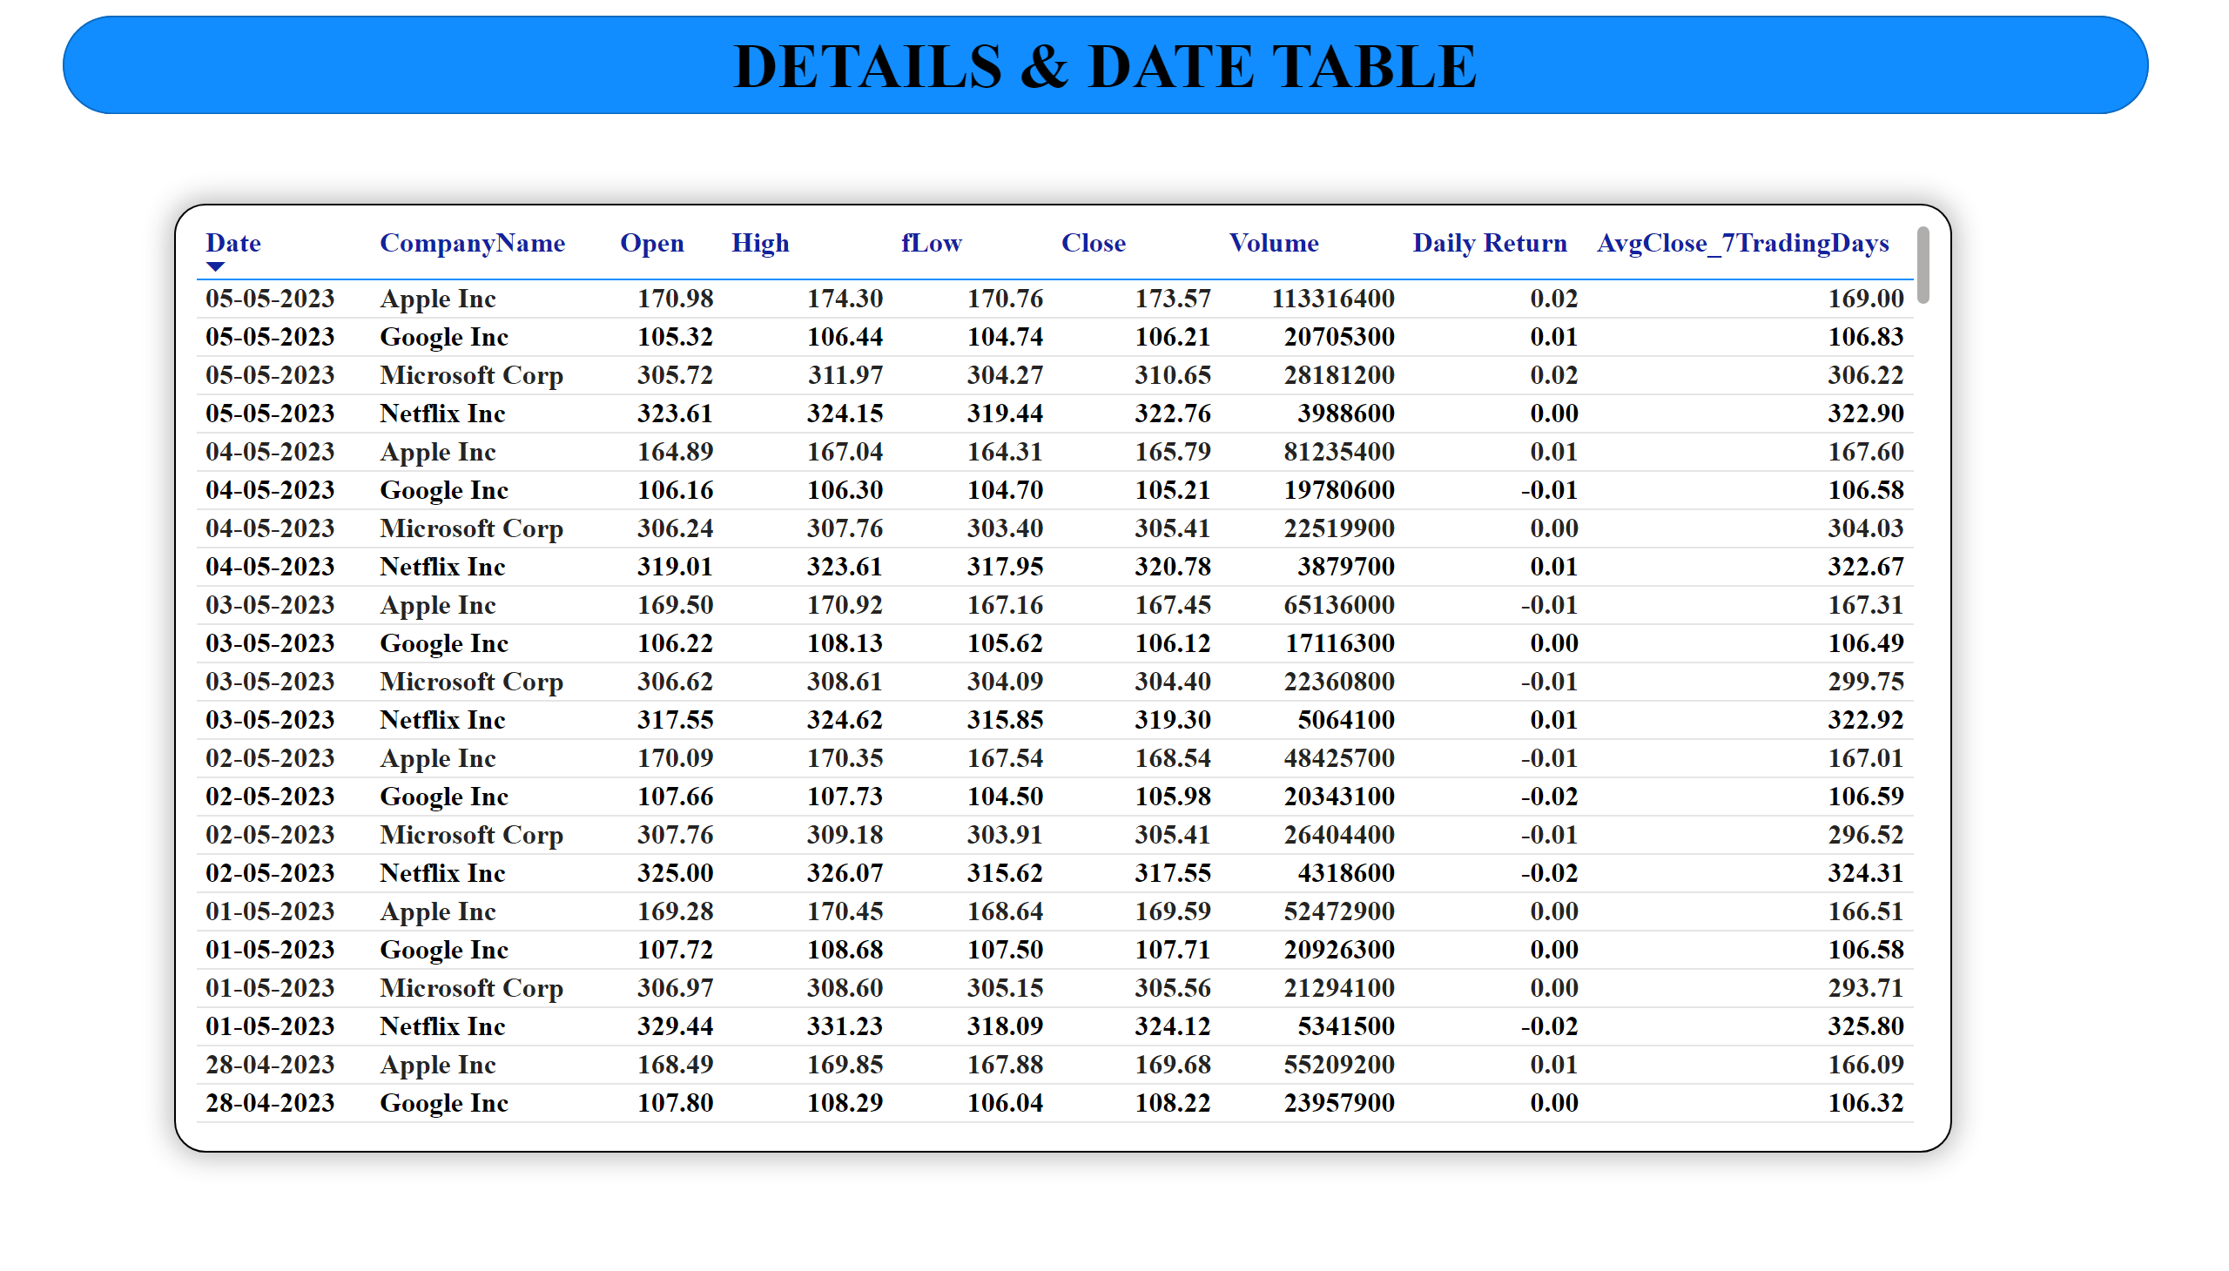
Insights:
Daily Open, High, Low, Close prices
Trading volume
Daily return values
7-day moving average
Purpose:
Enable detailed record-level analysis and validation.

Slide 12
KEY FINDINGS
Netflix Inc is the most volatile stock among the selected companies
Apple Inc leads in trading volume
Moving averages help identify underlying price trends
Volatility analysis assists in risk assessment
Comparative analysis supports informed investment decisions

Slide 13
CONCLUSION & FUTURE SCOPE
Conclusion
The Stock Market Analysis Dashboard effectively transforms historical stock price data into actionable insights. It helps analysts and investors understand trends, volatility, and comparative performance across major companies.
Future Enhancements
Longer time-period analysis
Technical indicators (RSI, MACD)
Correlation analysis between stocks
Integration with real-time market data

